Slide 1


Data Security with Electronic Medical Record (EMR) System

Slide 2

Self-introduction
used to work as a network engineer in telecommunication industry
Currently pursuing a M.S in Computer Science in Stony Brook University.
My interests focus on Networking and Cyber Security

Slide 3
Outline
Data
Database
SQL fundamentals
SQL injection

Slide 4
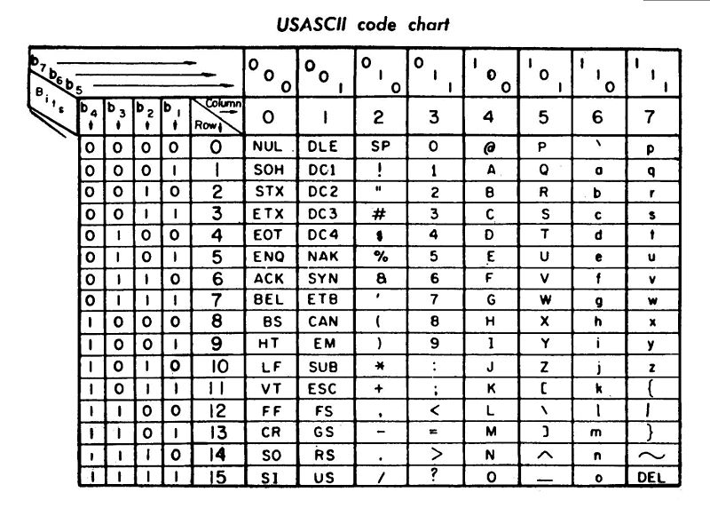
Something about Data
The data stored on computers is actually a sequence of 1 and 0. We use a kind of code to translate these 1/0 numbers into human-understood language.
Translation: (try by yourself)
Text: Hello world !
Binary:
01001000 01100101 01101100 01101100 01101111
00100000 01110111 01101111 01110010 01101100
01100100 00100000 00100001
one Byte

Slide 5
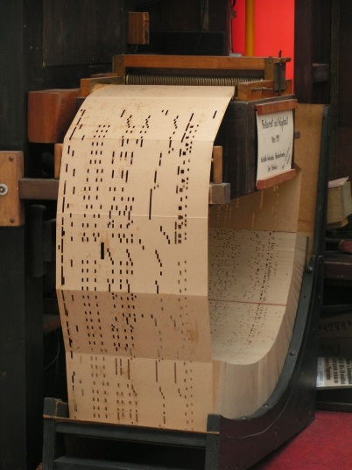
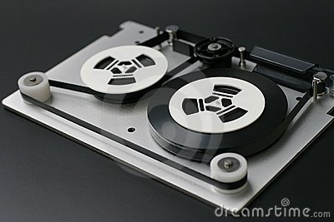
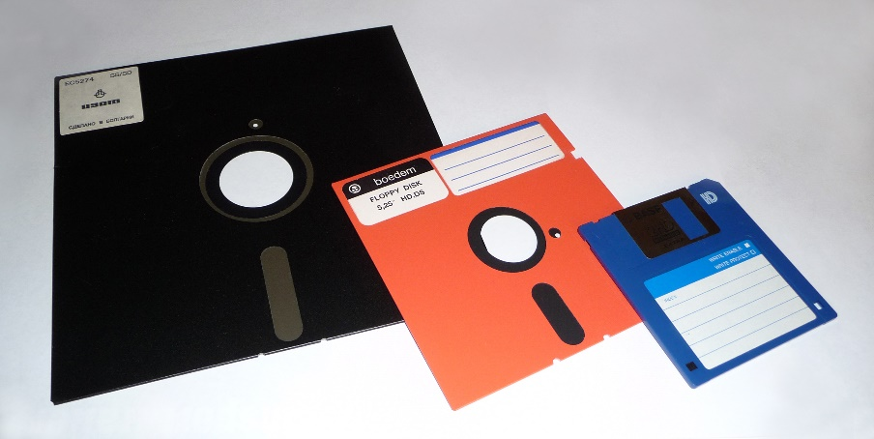




The evolution of data storage
http:/en.wikipedia.org/wiki/Floppy_disk/
Image:http://en.wikipedia.org
Image:http://en.wikipedia.org
http://newsroom.intel.com/
http://ixbtlabs.com//
Notes:
A punched card, punch card, IBM card, or Hollerith card is a piece of stiff paper that contained either commands for controlling automated machinery or data for data processing applications. Both commands and data were represented by the presence or absence of holes in predefined positions.

Slide 6
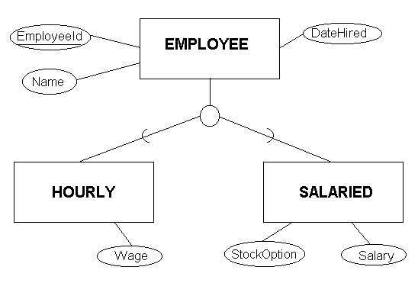
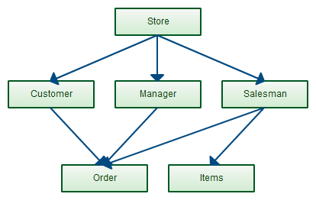
Database
A database is an organized collection of data .
A database contains many tables corresponding to different type of data.
According to management mode, there are three models of databases:
Relational model
Hierarchical model
Network model

Slide 7
How to manage a database
Database management systems (DBMSs) are specially designed software applications that help the user and other applications to capture and analyze data. (e.g., Microsoft SQL server, open-sourced MySQL, Oracle, and IBM DB2)
SQL (Structured Query Language) is a kind of programming language designed for managing data held in a relational database management system.
For example, using the following SQL statement can display all the OPENEMR users' information :
select * from openemr.users;

Slide 8
SQL and Relational Model terms
SQL | Relational Model | Description
ROW | TUPLE/RECORD | A data set representing a single item.
COLUMN | ATTRIBUTE/FIELD | A labeled element of a tuple.
TABLE | RELATION | A set of tuples sharing the same attributes; a set of columns and rows.
VIEW | DERIVED RELVAR | Any set of tuples; a data report from the RDBMS in response to a query.
Most relational databases are only engineering approximation to the relational model.

Slide 9
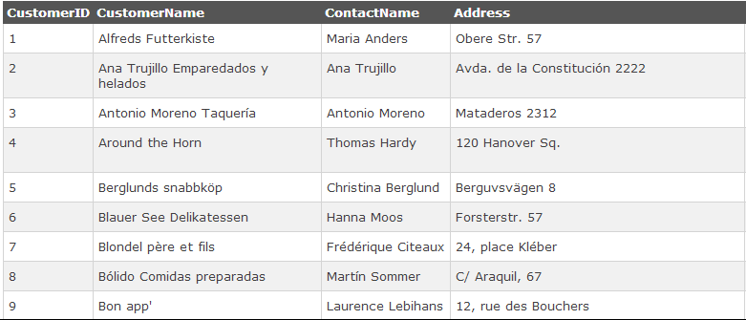
Example
Attributes(columns)
Primary Key
header
Tuples(rows)
A primary key is a attribute used to identify a row uniquely, so there are no two same primary keys.
Relation(table)
Notes:
A table is much like a spreadsheet, in that it's made up of rows and columns. All rows have the same columns, and each column contains the data itself.
In the relational model, each table schema must identify a column or group of columns, called the primary key, to uniquely identify each row.
The term relational does not just refer to relationships between tables: firstly, it refers to the table itself, or rather, the relationship between columns within a table; and secondly, it refers to links between tables.

Slide 10
Q & A
Question1:
Can there be any two tuples have the same values in a relation ?
Question2:
Can there be any two rows have the same values in an relational database table?
Relational Model is much more rigorous than Relational Database!!!
Notes:
Answer:
Absolutely cannot! In a relation, every tuple (row) should be unique. The primary key is used to guarantee the uniqueness. In SQL if you do not define a primary key, it is possible to insert multiple same rows into a table, so the primary key is very necessary in SQL.

Slide 11
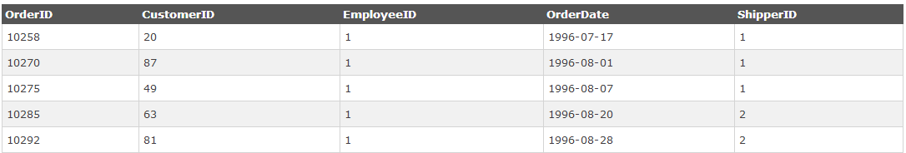
Primary key and Foreign Key
This is a table named orders:
OrderID is the primary key;
CustomerID, EmployeeID, and ShipperID are all foreign key (Foreign keys need not have unique values in the referencing relation).
foreign key: A foreign key is a field in a relational table that matches the primary key column of another table.

Slide 12
SQL fundamentals
We need to learn several SQL statements firstly:
CREATE
INSERT INTO
SELECT … FROM … WHERE
UPDATE
DELETE
UNION
Keep in mind: SQL is not case sensitive!!!
CREATE is the same as create .
You can use the W3C website to practice the examples:
http://www.w3schools.com/sql/trysql.asp?filename=trysql_select_all
Or download MySQL from :
http://dev.mysql.com/downloads/

Slide 13
CREATE
In SQL, CREATE statement is used to create a new relation/table.
CREATE TABLE students(
student_id INT NOT NULL,
firstname VARCHAR(45) NULL,
lastname VARCHAR(45) NULL,
course_id INT NULL,
PRIMARY KEY (student_id),
FOREIGN KEY (course_id)
REFERENCES courses (course_id)
);
CREATE TABLE courses(
course_id INT NOT NULL,
course_name VARCHAR(45) NULL,
professor_name VARCHAR(45) NULL,
semester VARCHAR(15) NULL,
PRIMARY KEY (course_id));
A new term here:
A Domain describes the set of possible values for a given attribute, and can be considered a constraint on the value of the attribute. E.g., the values of student_id must be an integer.

Slide 14
INSERT INTO
INSERT INTO statement is used to insert one record/tuple into an existed table.
INSERT INTO students
VALUES (1, 'Tom', 'Parker', 14001),
(2, 'Abe', 'Smith', 14001),
(3, 'Cathy', 'Brown', 14002),
(4, 'Tim', 'Duncan', 14003),
(5, 'Rob', 'Starker', 14004);
INSERT INTO courses
VALUES (14001, 'Database', 'Steve', '14SPR'),
(14002, 'Algorithm', 'Kifer', '14SPR'),
(14003, 'Web programming', 'Udit', '14SUM'),
(14004, 'Network', 'Butter', '14SUM');

Slide 15
SELECT…FROM…WHERE
SELECT…FROM…WHERE combination is used to retrieve a report or several reports from the database.
Example:
SELECT students.student_id, courses.course_name
FROM students, courses
WHERE students.course_id = courses.course_id;
SELECT column_name,column_name, …
FROM table_name
WHERE column_name operator value
AND column_name operator value
Determine the tables which to select data from. (FROM)
Select the specified rows which satisfy the requirements. (WHERE)
3. Select the required attributes from the selected rows. (SELECT)
Notes:
The SELECT statement is used to select data from a database.
The result is stored in a result table, called the result-set.

Slide 16
UPDATE and DELETE FROM
The UPDATE statement is used to update existing records in a table.
UPDATE table_name SET column1=value1,column2=value2,... WHERE some_column=some_value;
UPDATE students
SET course_id = 14004
WHERE student_id = 2;
The DELETE FROM statement is used to delete rows in a table
DELETE FROM table_name WHERE some_column=some_value;
DELETE FROM students
WHERE student_id = 2;

Slide 17
UNION and UNION ALL
The UNION and UNION ALL operators are used to combine the result-set of two or more SELECT statements.
SELECT City FROM Customers UNION ALL SELECT City FROM Suppliers
Requirements:
each SELECT statement within the UNION must have the same number of columns.
The columns must also have similar data types
Notes:
The UNION operator selects only distinct values by default. To allow duplicate values, use the ALL keyword with UNION.

Slide 18

SQL injection
Because SQL can be used to do anything, modifying, deleting and displaying any data stored in a database, it is the main object of the attackers.
SQL injection is one technique usually used to attack data-driven application. It is No.1 on the OWASP Top Ten Most Critical Web Application Security Risks.
The hackers can use this method to disclose
every bit of data in a whole system.
97%
www.tugberkugurlu.com
Notes:
Injection flaws, such as SQL, OS, and LDAP injection, occur when untrusted data is sent to an interpreter as part of a command or query. The attacker’s hostile data can trick the interpreter into executing unintended commands or accessing unauthorized data.

Slide 19
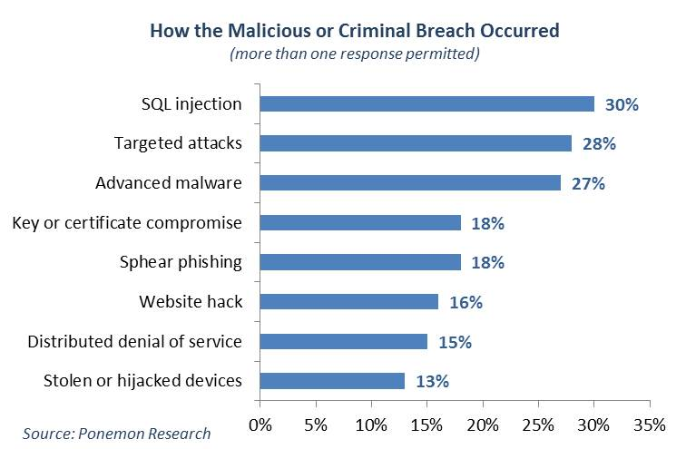

Slide 20



True Cases
March 2008, Heartland Payment System, a Fortune 1000 company that provides debit, prepaid, and credit card processing services, exposed 134 million credit cards through SQL injection.
Logo Source : http://logos.wikia.com
December 2008, the website of BusinessWeek was intruded via SQL injection, which result in that hundreds of pages were struck.
December 2009, Two NASA sites were hacked through SQL injection, and leaked 25 administrator accounts which can give authorization to manage and edit these websites.

Slide 21
Methods
Injection based on 1 = 1
Injection based on DROP
Union Query-based Injection
Error-based injection
Blind injection
Notes:
1. Error-based injection utilize the error or exception information to disclose some details about the internal implementation.
2. Blind SQLi relies on us getting a lot more implicit or in other words, drawing our conclusions based on other observations we can make about the behaviour of the app that aren’t quite direct. how can we make the app behave in an observable fashion such that it discloses the information we had earlier without explicitly telling us?

Slide 22
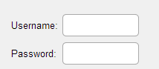
Injection based-on 1 = 1
The AND operator displays a record if both the first condition AND the second condition are true.
The OR operator displays a record if either the first condition OR the second condition is true.
‘ or 1=1 --
.$_POST[“username“].
abcd
.$_POST[“password“].
$query = “select Name, ID from Accounts where username='“.$_POST[“username“].“' and password='“.$_POST[“password“].“'“
select Name, ID from Accounts where username= ‘Username’ and password= ‘Password’
select Name, ID from Accounts where username= ‘’ or 1=1 - - ‘ and password= ‘abcd’
1=1 is always true;
All the string behind ‘—’ is regarded as a comment and ignored during run time.
select Name, ID from Accounts

Slide 23
Another Injection based-on 1 = 1
http://www.abc.com/user.php?userID=1
SELECT * FROM [users] WHERE userID = 1;
http://www.abc.com/user.php?userID=1 or 1=1
SELECT * FROM [users] WHERE userID = 1 or 1=1;

Slide 24
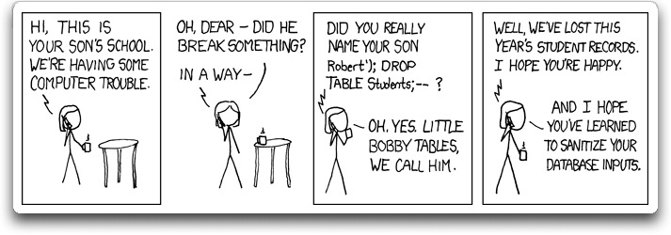
Bobby tables attack
A hacker do not know the username and password of a online system, but he can try this username :
Username: 110’; DROP TABLE users --
Password: abcd
http://xkcd.com/327/
select Name, ID from Accounts where username= ‘110’; DROP TABLE users - - ‘and password= ‘abcd’

Slide 25
Union Query-based Injection
Take an example, when we use an URL like http://www.books.com/books/?Typeid=1 a set of records are expected to be returned to the page. These records all belong to ‘typeid’ 1. This URL is equivalent to a SQL statement:
SELECT name FROM books where Typeid = 1;
The result is like this:
We can inject a UNION statement into this URL:
http://www.books.com/books/$Typeid=1 union all select name from sysobjects where xtype=‘u’ The injection can output the all table names of the database combined with the original output. Notice, the statements result combined by UNION must have the same column numbers! The result is like this:
SELECT name FROM books where Typeid = 1
UNION ALL
SELECT name FROM sysobjects where xtype=‘u’;
Webster
Longman
Collins
Webster
Longman
Collins
Books
Customers

Slide 26
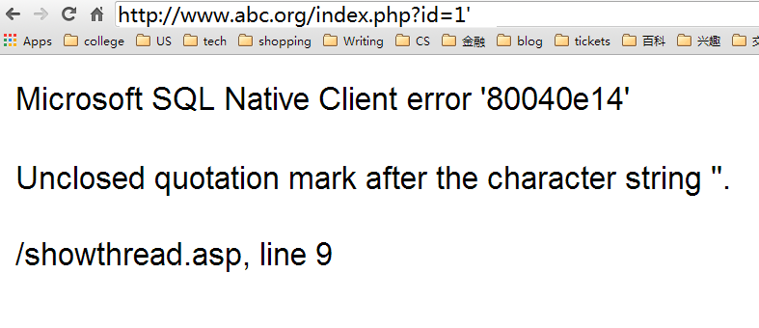
Error-based injection
When you change an URL http://www.abc.org/index.php?id=1 into
http://www.abc.org/index.php?id=1’ , an error may pop up to the browser like this:

Slide 27
Error-based injection cont’d
If we find a website has this kind of vulnerability, we can further our injection like this:
Add the following SQL statement behind the http://www.abc.org/index.php?id=1 and
convert(int, (
3 select top 1 name from sysobjects where id=(
2 select top 1 id from (
1 select top 1 id from sysobjects where xtype='u' order by id
) sq order by id DESC)))
Notes:
Working from the deepest nesting up, get the first record ID from the sysobjects table after ordering by ID. From that collection, get thelast ID (this is why it orders in descending) and pass that into the top select statement. That top statement is then only going to take the table name and try to convert it to an integer. The conversion to integer will almost certainly fail (please people, don’t name your tables “1” or “2” or any other integer for that matter!) and that exception then discloses the table name in the UI.

Slide 28
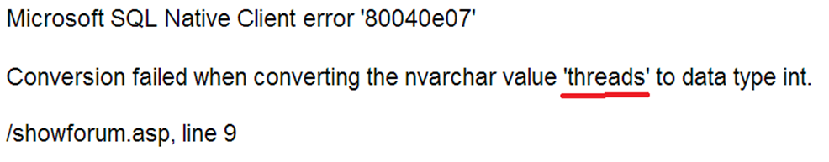
Error-based injection cont’d
You will get an error like this:

Slide 29
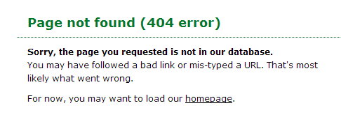
Blind injection
The error-based attacks are dependent on the exceptions that pop up to the browser. However, the experienced developers can hide the exceptions behind the browser, like this:

Slide 30
Blind injection (Boolean-based)
How could we bypass this barrier?
We can use the judgment statement to try and see.
E.g., we can inject a statement to judge if the first character is ‘a’ like this:
http://www.abc.org/index.php?id=1 and <statement: whether the first character of the table name is ‘a’ or not>
If the result is true (the name begin with ‘a’), the output don’t change, if false an error pop up.
Notes:
we were implicitly told the same information by virtue of the HTML response being different based on a true versus a false equivalency test.

Slide 31
SQL Injection Steps
Step1: Find the vulnerable websites using Google search.
e.g. inurl:index.php?id=
Step2: Detect the vulnerabilities. E.g., index.php?id=3’
Step3: Try to figure out the structure of the target website’s database:
the number of tables, the number of records and columns in
tables， the names of databases, tables and columns.
Step4: Use SQL injection to manipulate the data.

Slide 32
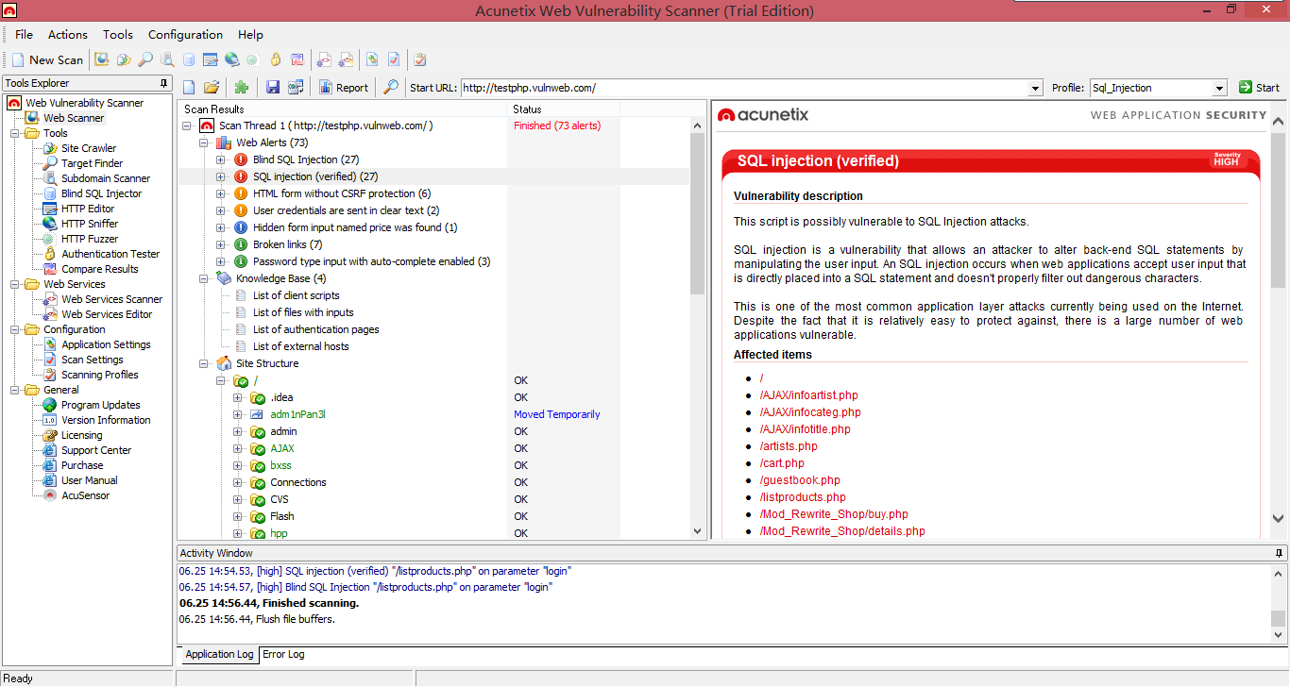
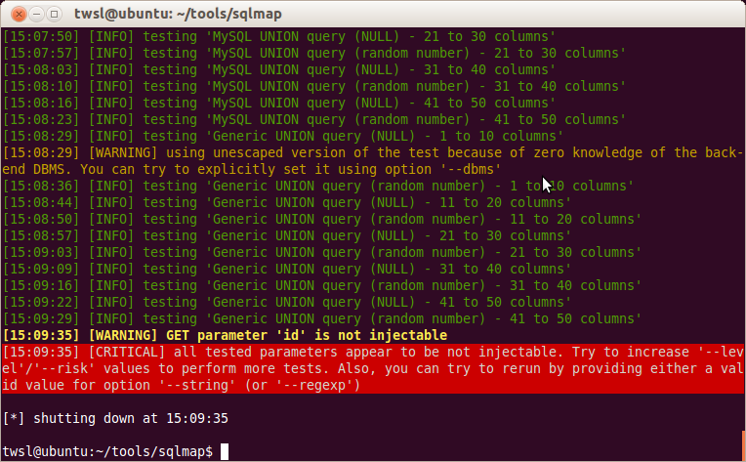
How to detect SQL injection flaws
A lot of website firewalls and web vulnerabilities scanner can be deployed to detect SQLi.

Slide 33
How to counter SQL injection
SQL Whitelisting
Disable multiple statements.
OWASP’s prevention cheat sheet
Web Application Firewalls
Data encryption
SQL injection
Unintended query
Untrusted data
=
+
Notes:
The above example could only happen because of a series of failures in the application design. Firstly, the CategoryID query string parameter allowed any value to be assigned and executed by SQL Server without any parsing whatsoever. Although we would normally expect an integer, arbitrary strings were accepted.
Secondly, the SQL statement was constructed as a concatenated string and executed without any concept of using parameters. The CategoryID was consequently allowed to perform activities well outside the scope of its intended function.
Finally, the SQL Server account used to execute the statement had very broad rights. At the very least this one account appeared to have data reader and data writer rights. Further probing may have even allowed the dropping of tables or running of system commands if the account had the appropriate rights.

Slide 34
Analysis
Let’s analyze one example:
Products.php?CategoryID=1;update products(productname) productname = ‘hacker’
We can find out where the flaws are:
1. CategoryID parameter should be an integer, but here it can be assigned any values and executed by the server without check.
2. Multiple statements should not be allowed.
3. The SQL server account used to execute the statement should not have high privilege (data writer rights).

Slide 35
SQL Whitelisting
All input must be validated against a whitelist of fitting value ranges.
We assume all the input may be malicious. If we use blacklist, it will be very huge and inflexible.
Var CID = Request.QueryString[“CatergoryID"];
var positiveIntRegex = new Regex(@"^0*[1-9][0-9]*$");
if(!positiveIntRegex.IsMatch(CID)) {
lblResults.Text = "An invalid CategoryID has been specified.";
return; }
blacklist
whitelist
Regular Expression:
a regular expression (abbreviated regex or regexp) is a sequence of characters that forms a search pattern, mainly for use in pattern matching with strings, or string matching.
-- Wikipedia
Notes:
Just this one piece of simple validation has a major impact on the security of the code. It immediately renders all the examples further up completely worthless in that none of the malicious CategoryID values match the regex and the program will exit before any SQL execution occurs.

Slide 36
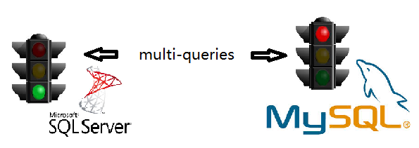
Disable Multiple Statements
Some injections contain multiple statements, like:
Products.php?ProductID = 2;update products(productname) productname = ‘hacker’;
The MySQL is safer than SQL server system on this problem, because the MySQL client API does not permit multi-queries by default.
the SQL server supports multi-queries by default, so the developers need to find a method to disable it.

Slide 37
Parameterised stored procedures
CREATE PROCEDURE GetProducts (@ProductID INT)
AS
SELECT *
FROM db.Products
WHERE ProductID = @ProductID
GO
GRANT EXECUTE ON GetProducts TO <Users>
GO
-- @ProductID is the input parameter. It is defined as an integer.
-- Grant Execute is used to grant the permission to specified users for executing this procedure.
Parameterised stored procedures are an additional defence to parsing untrusted data against a whitelist.

Slide 38
OWASP prevention cheat sheet
OWASP (Open Web Application Security Project) is an online community dedicated to web application security.
OWASP prevention cheat sheet is focused on providing clear, simple, actionable guidance for preventing SQL Injection flaws in your application. It is a very good tool to help the developers cope with the SQL injections. If you are interested in SQL injection and want to study it further, you can read the document through this link:
https://www.owasp.org/index.php/SQL_Injection_Prevention_Cheat_Sheet

Slide 39
Web Application Firewalls
A web application firewall (WAF) is an appliance, server plugin, or filter that applies a set of rules to an HTTP conversation. It is specially designed to protect web applications and servers from web-based attacks that traditional firewall cannot defend.
http://rumy.alghazzawigroup.netdna-cdn.com/

Slide 40

Data Encryption
Once the Database Management System is compromised, we need a second layer protection to protect the e-PHI and patient privacy information from being exposed to the hackers.
If the former methods are regarded as the barriers to
the attackers, then data encryption is the final fort.

Slide 41
Thank you !

Slide 42
References
www.Wikipedia.com
http://www.w3schools.com/
Article “Everything you wanted to know about SQL injection”:
http://www.troyhunt.com/2013/07/everything-you-wanted-to-know-about-sql.html
“The SQL Injection Threat Study”, by DB network, April 2014
“SQL Injection Attacks and Solutions”, Dr. Natarajan Meghanathan, Jackson State University
SQLMAP : http://sqlmap.org/
Acunetix: www.acunetix.com

